Slide 1


Nike Inc. Trading Strategy Analysis
This presentation analyzes Nike Inc. (NKE) stock performance from 2005-2025. We'll examine return statistics, time series modeling, and compare three trading strategies.
By: Charlie Yi

Slide 2
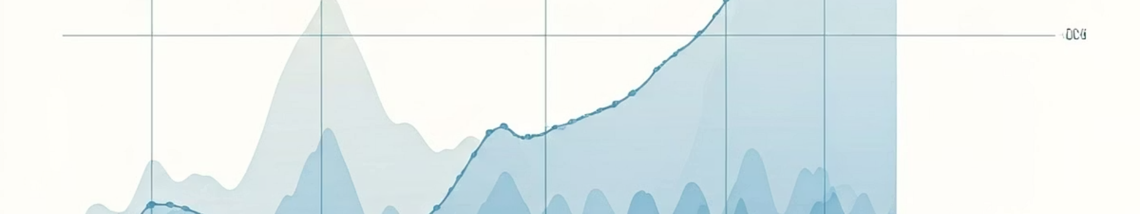
Data Overview & Statistics
5,032
11.2%
28.9%
Trading Days
Annual Return
Volatility
Daily adjusted closing prices from March 2005 to February 2025
Mean annualized log return
Annualized standard deviation
The return distribution shows negative skewness (-0.21) and high excess kurtosis (12.72). This indicates fatter tails than a normal distribution.

Slide 3
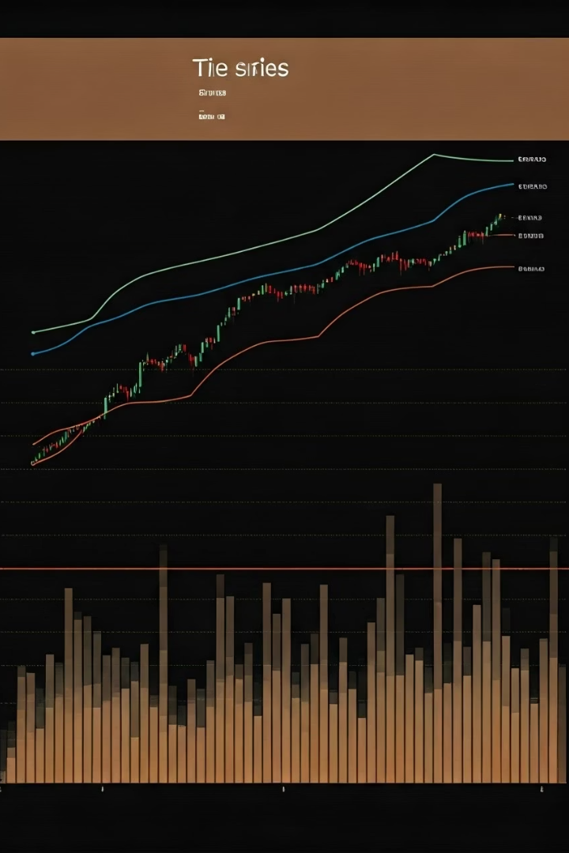



Time Series Modeling
Model Selection
ARIMA(1,0,1) with non-zero mean identified as best fit
Parameter Estimation
AR(1): 0.7150, MA(1): -0.7563, Mean: 0.0004
Stationarity Confirmed
ADF test statistic: -17.5 (p-value: 0.01)

Slide 4




Trading Strategies Implemented
Buy-and-Hold (B&H)
Time Series Momentum (TSM)
Simple strategy of buying and holding the stock throughout the period
252/21 day lookback/holding period configuration
Simple Moving Average (SMA)
126/30 day short/long moving average crossover selected as optimal

Slide 5








10-Year Rolling Window Performance
Returns
Sharpe Ratio
B&H: 18.0% > TSM: 13.2% > SMA: 7.3%
B&H: 0.747 > TSM: 0.665 > SMA: 0.499
Significance
Max Drawdown
All performance differences statistically significant (p < 0.001)
TSM: 33.8% < SMA: 34.6% < B&H: 43.0%

Slide 6
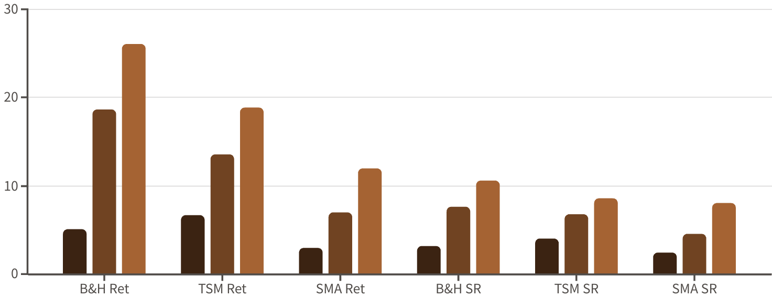
Performance Distribution
Min
Median
Max
B&H shows highest returns but widest distribution. TSM offers moderate returns with less variability. SMA provides lowest returns with moderate variability. Sharpe Ratio show similar ranking for risk-adjusted returns (Sharpe Ratio)

Slide 7

Key Findings & Conclusions
B&H Superiority
Risk Tradeoff
Buy-and-Hold significantly outperformed both TSM and SMA strategies in terms of returns and Sharpe ratio.
B&H showed highest returns but also highest drawdowns (43%). TSM and SMA offered better downside protection.
Statistical Significance
All performance differences between strategies were statistically significant (p < 0.001).

